Slide 1
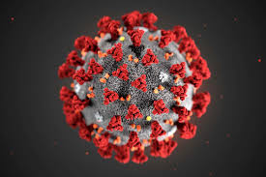
Exploring the Severity of Different Covid-19 Strains
Team D-001
https://www.newscientist.com/term/covid-19/

Slide 2







Ahmed Gobba
Mathematical, Computational and Statistical Sciences (Honours) student at Yale-NUS College, Singapore
Aboli Marathe
Pune Institute of Computer Engineering, India
Dr. Raouf Hajji, MD
Assistant Professor of Internal Medicine, Medicine Faculty of Sousse, Tunisia
Sumin Lan
Biomedical Engineering, Masters Student, Duke University
Ruby Zhang
Grad. Student, Data Science, Harvard University
Faith Ilesanmi MBChB MPH
Grad. Student, Epidemiology, UMass Amherst

Slide 3
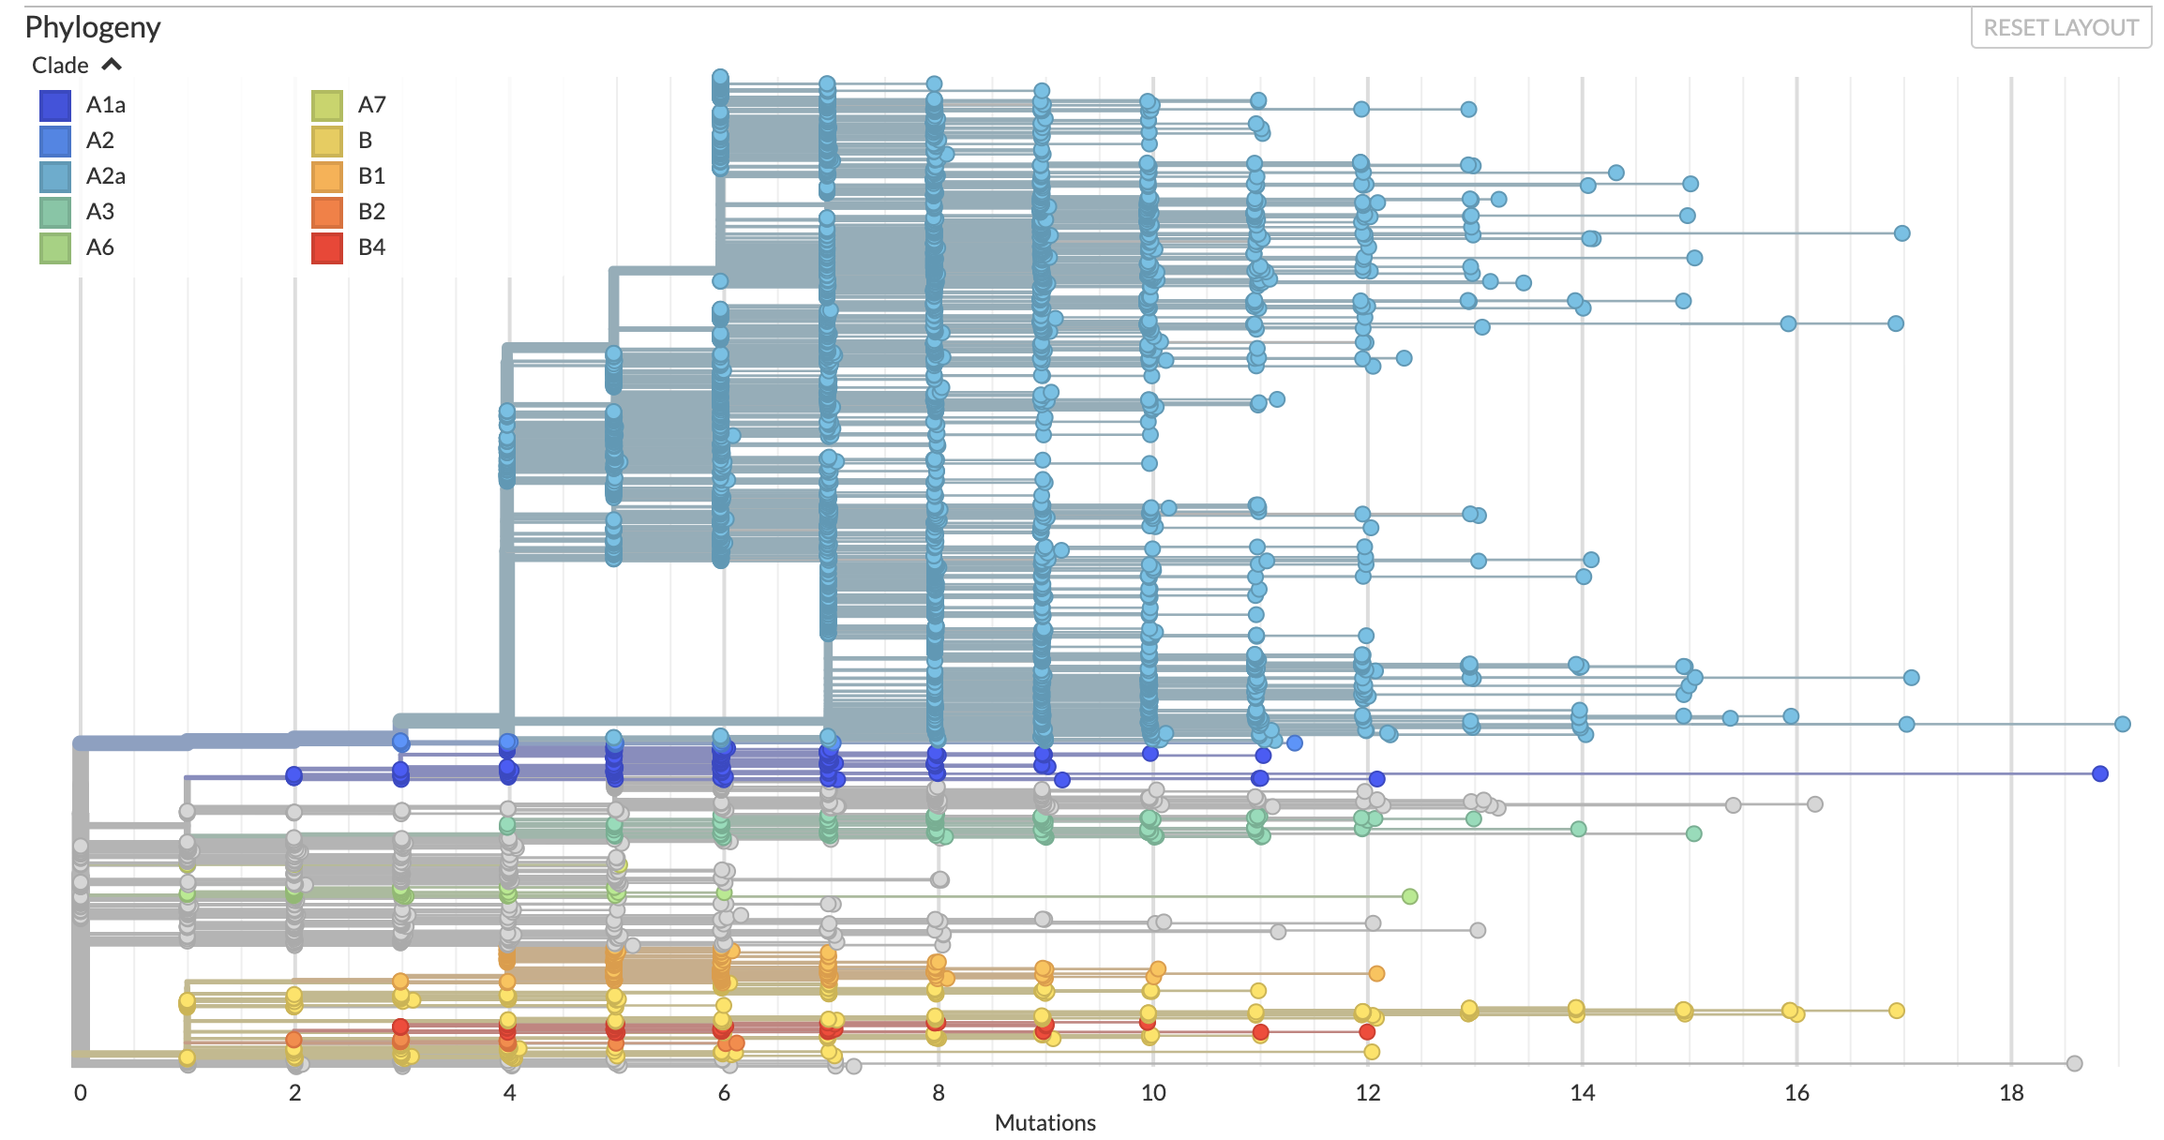
Background
More than 10,000 sequences of COVID-19 virus sampled so far.
Based on mutation evolution they are grouped into clades.
Notes:
Analyse the severity of SARS COV-2 strain by strain in a bid to abate deaths, and prepare for resurgence.
Which COVID-19 strains have been correlated with the most severe outcomes up to date?

Slide 4
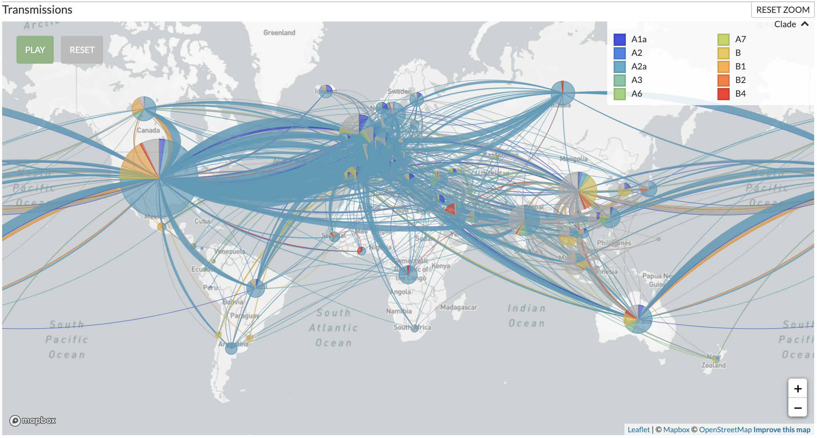
Background
The strains from the same clade were found in different locations.
Some clades were found more commonly than others.
Notes:
The estimated mean evolutionary rate for 2019‐nCoV ranged from 1.7926 × 10−3 to 1.8266 × 10−3 substitutions per site per year. positively impact public health in terms
Epidemiological investigations and genomic data surveillance could guide prevention efforts to reduce COV-19 transmission (Li et al., 2020).
Phylogenetic analysis validly assesses the transmission dynamics for COVID-19 and guides prevention (Giovanett et al., 2020).
Establishing a reference sequence for SARS-CoV-2 could benefit not only biological study of this virus but also diagnosis, clinical monitoring and intervention of SARS-CoV-2 infection in the future (Wang et al., 2020).
Valuable for highlighting specific patterns related to the circulation of the virus and assessing the impact of intervention measures (Dellicour et al., 2020).
https://medicalxpress.com/news/2020-05-virus-mutations-stronger-strain-experts.html Mutation doesn’t mean systematically more severe disease. If we know where mutation is going we can estimate either more preparedness or encourage to ease the lockdown. (Dr. Raouf).

Slide 5
Research Questions
What are the the different clusters (lineages) of COVID-19 strains?
Which of these lineages (if any) are most correlated with outcome severity?
Notes:
Li et al., 2020; Wang et al., 2020;
Dellicour et al., 2020; Giovanett et al., 2020:
All emphasize SARS-COV2 genomic surveillance can guide prevention efforts and improve clinical intervention.

Slide 6
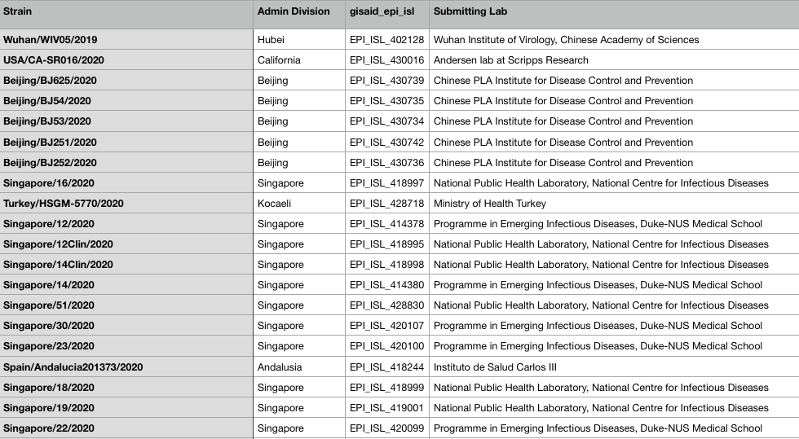
Data: Main Dataset
GISAID DATASET^{[1]}:
[1] Source: https://nextstrain.org/ncov/global
Notes:
different strains according to geographical repartition, spread between countries, date and laboratories of identification.

Slide 7
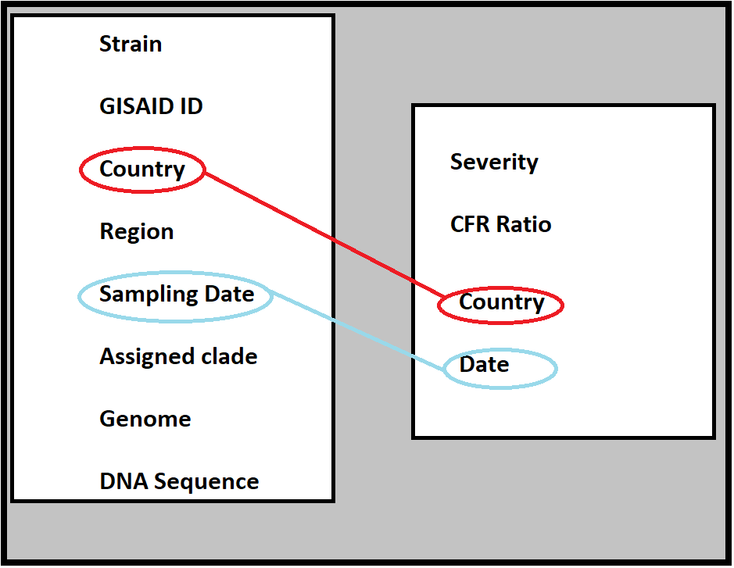
Data: Complementary Data
To find the impact of a strain on a country, we have combined the GISAID data with Severity Data,in a time series analysis, to correlate severity with presence of strain on a particular day.
The linking of the 2 datasets is through the Date and Country labels.

Slide 8
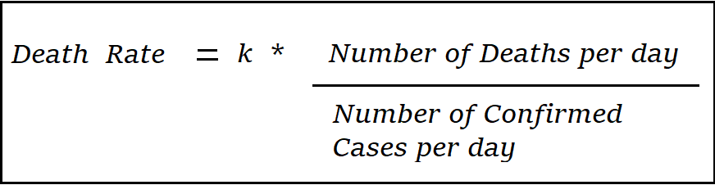
Data: Quantifying Severity
Quantify the Severity
The severity has been quantified, by the CFR or Case - Fatality Ratio, over a span of over 4 months.
Severity Classification
According to CDC Flu Severity Classification, the death rate per day can be used to analyze the severity per countries.
Our formula is given by:
Here k= 0.1, for processing the data for the model.

Slide 9
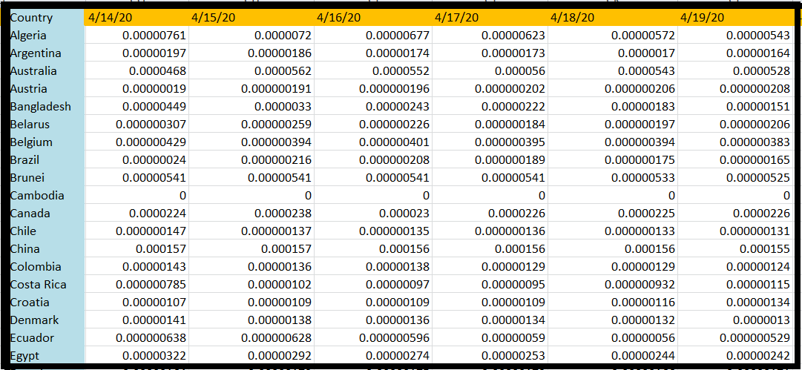
Data: Quantifying Severity
The columns of the Severity table for 4 months.
Each cell represents the death rate per day per country.

Slide 10
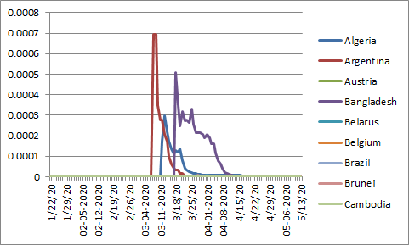
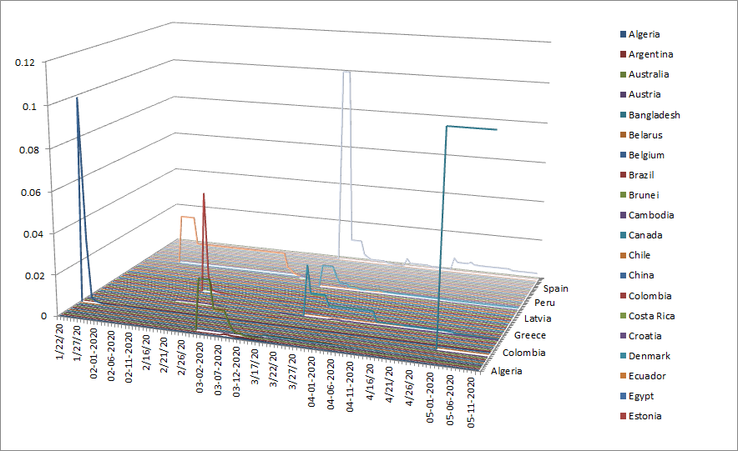
Data: Quantifying Severity
Additional graphs can be found in Appendix B

Slide 11
Data: Quantifying Severity
Country | Severity (Based on Death Rate)
China | High Severity (one peak 0.1%)
Argentina | High Severity (one peak 0.07%)
Bangladesh | High Severity (one peak 0.05%)
Algeria | High Severity (one peak 0.03%)
Ghana | High Severity (one peak 0.0255%)
Italy | High Severity (one peak 0.025%)
Japan | High Severity (one peak 0.015%)
Kazakhstan | High Severity (one peak 0.015%)
Philippines | High Severity (one peak 0.01%)
The choice of the threshold depends on the clinical implication.
Without any prior data, it is difficult to provide any quantitative means to determine the threshold.
Thus, we selected the countries with the 9 highest death rates during 3 months.
We may need further work on detailed threshold exploration.

Slide 12
Methodology: Lineage Identification
Consensus Sequencing
Choosing Clade Representative
Compute Distance Matrix
Establish Divergence Threshold for Grouping
For each clade, find the consensus sequence using the consensus function (seqinr package) in R.
For each clade, choose the sequence closest to the consensus sequence as the representative of the clade.
Compute the matrix of the divergence distance between each pair of representatives using the dist.alignment function (seqinr package) in R.
We choose the divergence threshold of 1% for two clades to be considered to belong to different lineages.
Source: https://cran.r-project.org/web/packages/seqinr/index.html

Slide 13
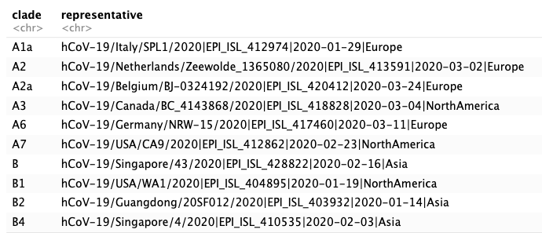
Results: Lineage Identification
Clade Representatives based on Consensus Sequencing

Slide 14
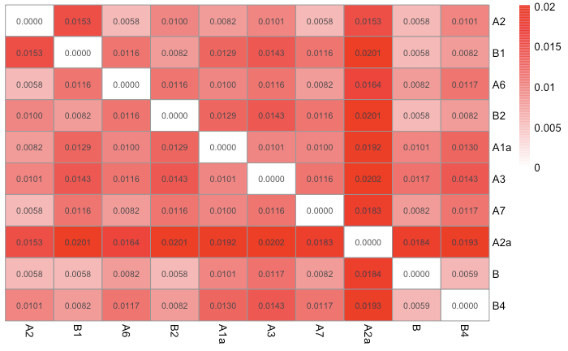
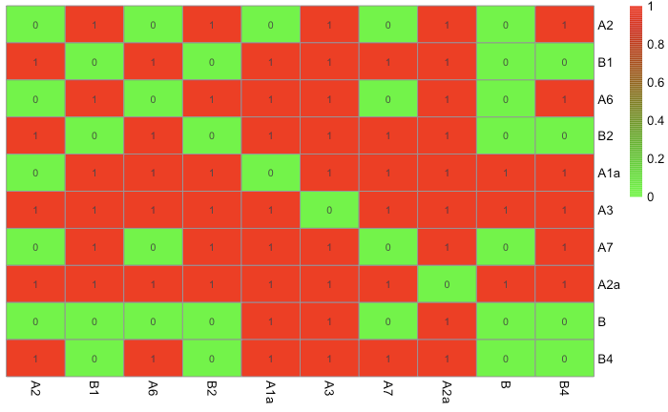
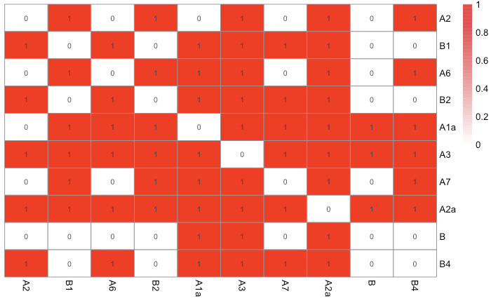
Results: Lineage Identification
Distance Matrix of Clade Representatives
Indicator Matrix of Lineage Grouping

Slide 15
Results: Lineage Identification
Lineage 1 | Lineage 2 | Lineage 3 | Lineage 4
B B1 B2 B3 | A1a A2 A6 A7 | A2a | A3

Slide 16
Methodology: Relationship between lineages and severity
How to model the relationship between lineages and severity?
Predictors
Cumulative number of samples for each lineage
Time: 1/22/2020 - 5/13/2020
Response: Severity [0,1)
Model: zero-inflated beta regression model
To deal with an excess of zeros
Aggregation level: Country
We chose 7 countries (have at least 2 lineages)
Australia, Canada, China, Germany, Thailand, Belgium, India
Data for country
day | Lineage 1 | Lineage 2 | Lineage 3 | Lineage 4
1 | 0 | 1 | 0 | 0
2 | 1 | 2 | 0 | 0

Slide 17
Methodology: Relationship between lineages and severity
How to model the relationship between lineages and severity?
Assumptions
No high-order interaction effect
Lineage & lineage, lineage & time
Pairwise comparison: Use lineage 1 as the reference
logit(severity for one county) = beta1 * L1 + beta2 * L2 + beta3 * L3 + beta4 * L4 + beta5 * time
Beta 1: effect of lineage 1 on logit(severity)
Beta 2, 3, 4: effect of lineage on logit(severity) relative to lineage 1
Notes:
control for no of hospital beds, no of Doctors per capita to make sure mortality is only due to the virus not lack of preparedness.
controlling for differences between geographical locations such as healthcare facilities, population demographics, etc.
Response variable: mortality, frequency they show up in terms of genomic sampling and proportion of each strain (probability of being in the population).
Normalize the number of cases by time.
Data is a random sampling of genotype
Model???
Correlate cases with specific strains at diff times???
mortality versus hospitalization, Number of critical cases and number of deaths can be combined.
confirmed cases/ no of tests to measure infectivity.

Slide 18
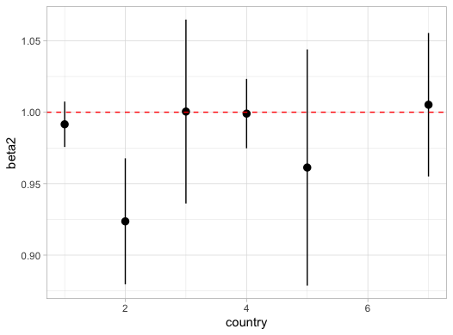
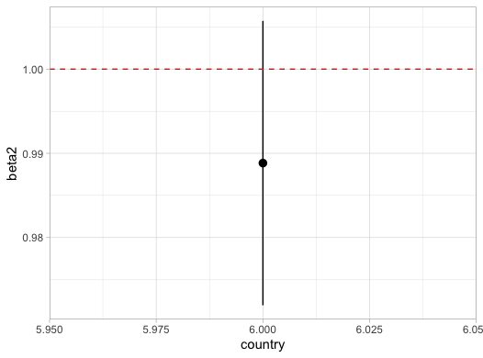
Results: Relationship between lineages and severity
95% Confidence Interval for Odds Ratio of lineage 2 vs 1
95% Confidence Interval for Odds Ratio of lineage 3 vs 1
6 countries without Belgium
Belgium

Slide 19
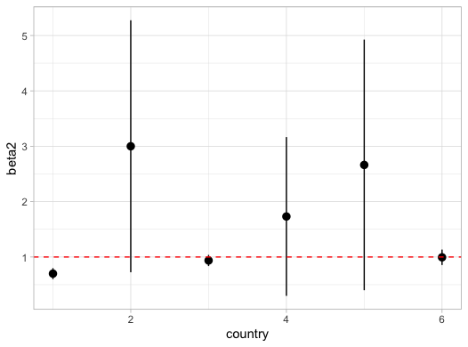
Results: Relationship between lineages and severity
95% Confidence Interval for Odds Ratio of lineage 4 vs 1
No significant difference between lineage 1 and 2,3,4 in terms of effect on severity
6 countries without Belgium

Slide 20
Conclusions
The impact of the COVID-19 outbreak can be curtailed with:
The distance between lineages falls between (0.00 - 0.02) and is insufficient to consider them as different genotypes.
There is no significant difference in the association between each of the lineages and severity of outcome.
Notes:
The impact of the COVID-19 outbreak can be curtailed with the assessment of severity strain by strain, ability to distinguish asymptomatic cases from debilitating cases, and availability of required vaccine(s) for various strains of SARS COV-2. This would enable health care workers to effectively triage patients, reduce the burden of hospitalizations, therefore, enable countries to successfully mitigate the current pandemic and prepare for future waves.

Slide 21
Implications
The virus has only mutated for a short period of time.
Up to our knowledge, the difference between strains does not currently affect the severity of outbreak in a country.
Notes:
https://medicalxpress.com/news/2020-05-virus-mutations-stronger-strain-experts.html Mutation doesn’t mean systematically more severe disease. If we know where mutation is going we can estimate either more preparedness or encourage to ease the lockdown. (From Dr. Raouf).
Show less

Slide 22
Future Work
Modeling
Include interactions between lineages and between time and lineages
Use spline functions for predictors to incorporate nonlinearity
Collect more data on countries and include as many countries as possible
Data
To collect extensive data on the antibodies testings which would provide a well rounded estimate of the severity.

Slide 23
Thank you!
For more information about code used and results plots, please visit the project repository at https://github.com/Infernolia/D_001

Slide 24
References
Dellicour, S., Durkin, K., Hong, S. L., Vanmechelen, B., Martí-Carreras, J., Gill, M. S., ... & Walker, C. (2020). A phylodynamic workflow to rapidly gain insights into the dispersal history and dynamics of SARS-CoV-2 lineages. bioRxiv. https://www.biorxiv.org/content/10.1101/2020.05.05.078758v1.abstract
Giovanetti, M., Benvenuto, D., Angeletti, S., & Ciccozzi, M. (2020). The first two cases of 2019‐nCoV in Italy: Where they come from?. Journal of medical virology. https://www.ncbi.nlm.nih.gov/pmc/articles/PMC7166327/
GISAID (2020). NextStrain COVID-19 situation report. https://nextstrain.org/ncov/global . Retrieved 05/10/2020
Global Change Data Lab (2020). Coronavirus pandemic (COVID-19) –the data. Our World in Data https://ourworldindata.org/coronavirus-data Retrieved 05/10/2020
Kim, J., Li, J., Kim, M., Jang, S., Ryoo, S., In, Y., Yu, B. (2020). DataScience for COVID-19 in south korea. https://www.kaggle.com/kimjihoo/coronavirusdataset#PatientInfo.csv Retrieved 05/10/2020
Li, X., Wang, W., Zhao, X., Zai, J., Zhao, Q., Li, Y., & Chaillon, A. (2020). Transmission dynamics and evolutionary history of 2019‐nCoV. Journal of medical virology. https://onlinelibrary.wiley.com/doi/full/10.1002/jmv.25701
Li, Y., Liu, B., Cui, J., Wang, Z., Shen, Y., Xu, Y., & Yao, K. (2020). Similarities and evolutionary relationships of COVID-19 and related viruses. arXiv preprint arXiv:2003.05580.https://arxiv.org/abs/2003.05580
Wang, C., Liu, Z., Chen, Z., Huang, X., Xu, M., He, T., & Zhang, Z. (2020). The establishment of reference sequence for SARS‐CoV‐2 and variation analysis. Journal of medical virology, 92(6), 667-674. https://pubmed.ncbi.nlm.nih.gov/32167180/?from_term=the+most+severe+strain+of+covid19&from_pos=3
The complete list of references can be found at here.
The preparedness analysis is available in Appendix B.

Slide 25
APPENDIX

Slide 26
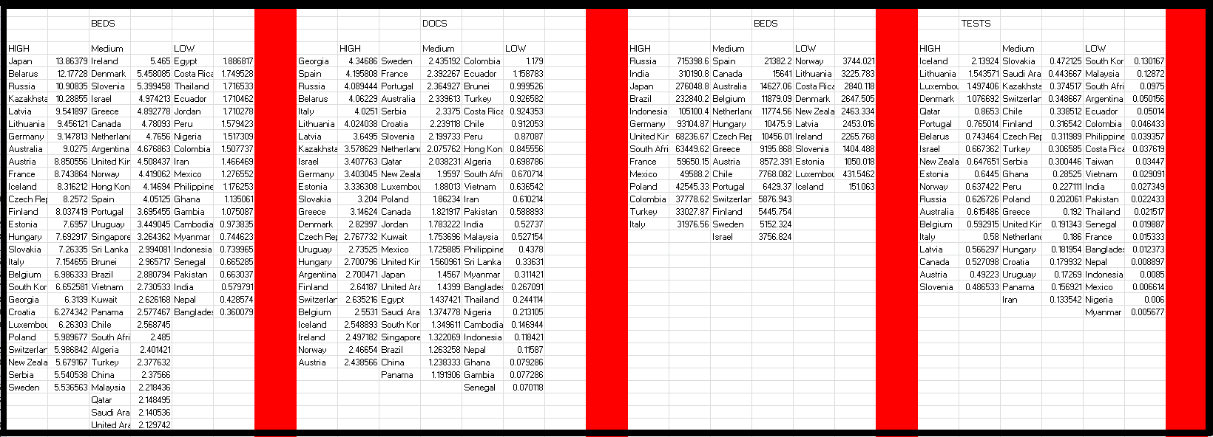
Appendix A: Extra Work
Measuring Preparedness
Degree of preparedness calculated measuring:
Total No. of tests done/Total No. of confirmed cases
No. of physicians per 100,000 ppl
No. of hospital beds per 100,000 ppl in 2020
Average hospital beds over the past 2 decades (gives a close estimate of the established healthcare facilities per country).
A weighted average of these 4 factors, and multiplication with a constant was taken to give the final value of preparedness.
Factor | Weight
Tests/Confirmed Cases*10000^{[1]} | 50%
Physicians/100,000 | 16.67%
Beds/100,000 | 16.67%
Historical bed data | 16.67%
[1]: This constant was chosen to scale the ratio column, for coherence
Notes:
The preparedness of a country is a complex measure, which depends on many factors, both present and historical.
We have calculated the degree of preparedness by measuring:
Total No of tests done/Total No of confirmed cases
No of physicians per 100,000 ppl
No of hospital beds per 100,000 ppl in 2020
Average of hospital beds over the past 2 decades, which gives a good idea of the established healthcare facilities of the country.
A weighted average of these 4 factors, and multiplication with a constant was taken to give the final value of preparedness.

Slide 27
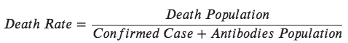
Severity Analysis
In the future, once sufficient data on antibody testing is procured, the CFR can be modified to the following formula:
Discovery Rate can also be included in the analysis, if additional data is assimilated
Notes:
Strikingly, we observed divergence of COVID-19 strains isolated from human hosts has steadily increased from December 2019 to March 2020, suggesting COVID-19 is actively evolving in human hosts. From all existing human COVID-19 genome sequences, we calculated the first common model that represents the shared sequences of the human COVID-19 strains, which provides important information for vaccine and antibody development. Geographic and time- course analysis of the evolutionary trees of the human COVID-19 reveals possible evolutional paths among strains from 21 countries. This finding has important implications to the management of COVID-19 and the development of vaccines. https://arxiv.org/pdf/2003.05580.pdf
retrieved 95 full‐length genomic sequences of SARAS‐CoV‐2 strains from the National Center for Biotechnology Information and GISAID databases, established the reference sequence by conducting multiple sequence alignment and phylogenetic analyses, and analyzed sequence variations along the SARS‐CoV‐2 genome. findings suggested that there may be selective mutations in SARS‐COV‐2, and it is necessary to avoid certain regions when designing primers and probes. Establishment of the reference sequence for SARS‐CoV‐2 could benefit not only biological study of this virus but also diagnosis, clinical monitoring and intervention of SARS‐CoV‐2 infection in the future. https://pubmed.ncbi.nlm.nih.gov/32167180/?from_term=the+most+severe+strain+of+covid19&from_pos=3

Slide 28
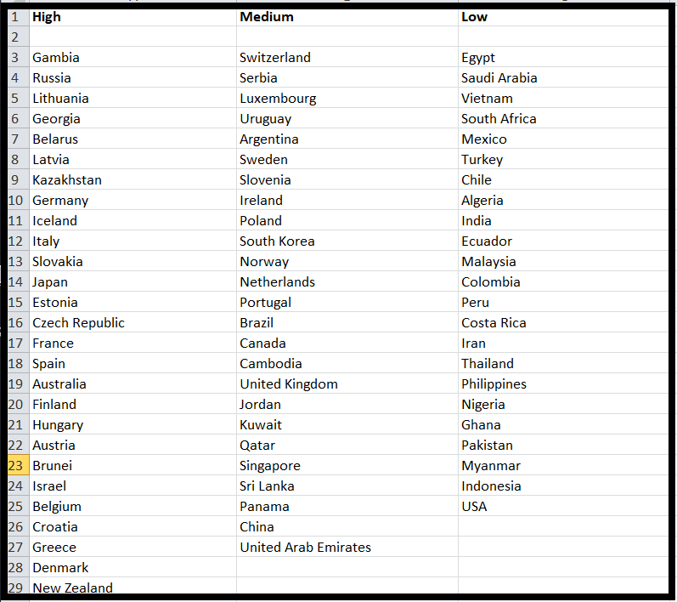
Measuring Preparedness: Result

Slide 29
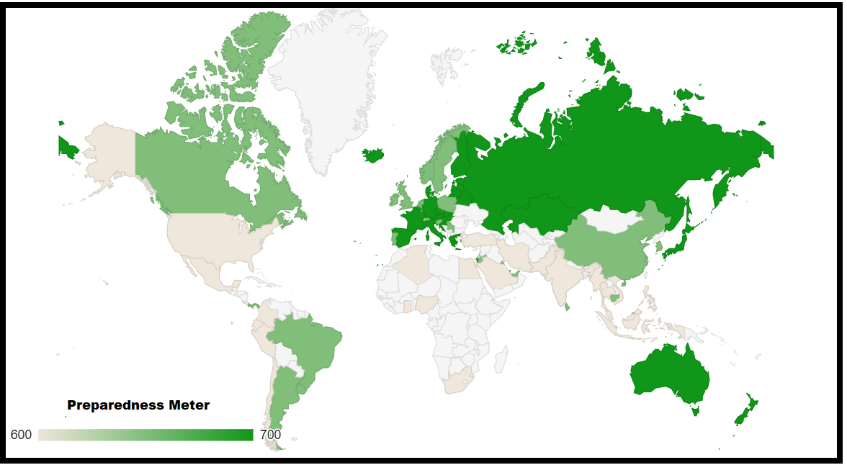
Graphs
Note:
1.The preparedness meter is a temporary scale and represents degree of preparedness, not actual values.
2. The white regions are of the countries omitted from calculations, due to missing data and do not indicate 0 preparedness.

Slide 30
Measuring Preparedness: Review
Some countries do not report accurate testing rates. This may damage the reliability of the preparedness metric.
The combination of our algorithm with a misinformation model, or a better metric could solve this issue.
With the existing data, finding misinformation on a cellular level is impossible!
As COVID-19 is very recent, the hospital utilization/healthcare data has not been recorded significantly and this data could make both the severity and preparedness much more accurate!

Slide 31
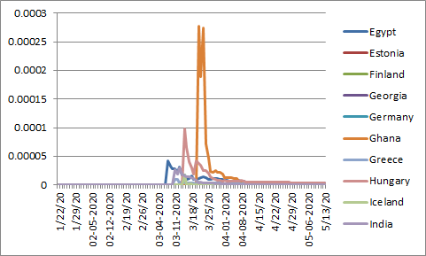
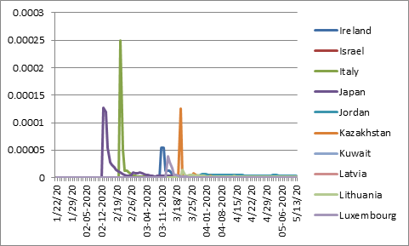
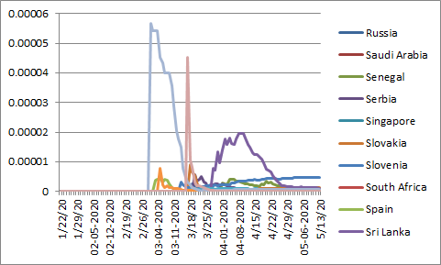
Appendix B: Quantifying Severity

Slide 32
